Slide 2
Norway – Japan Maritime Green Innovation Seminar
Norwegian ambitions and experiences
Thursday, May 4th
Hanna Lee Behrens
Executive Director
Norwegian Shipowners’ Association

Slide 3


NSA Environmental vision
Norwegian shipping and offshore contractors shall have no harmful emissions or discharges to air or water

Slide 4
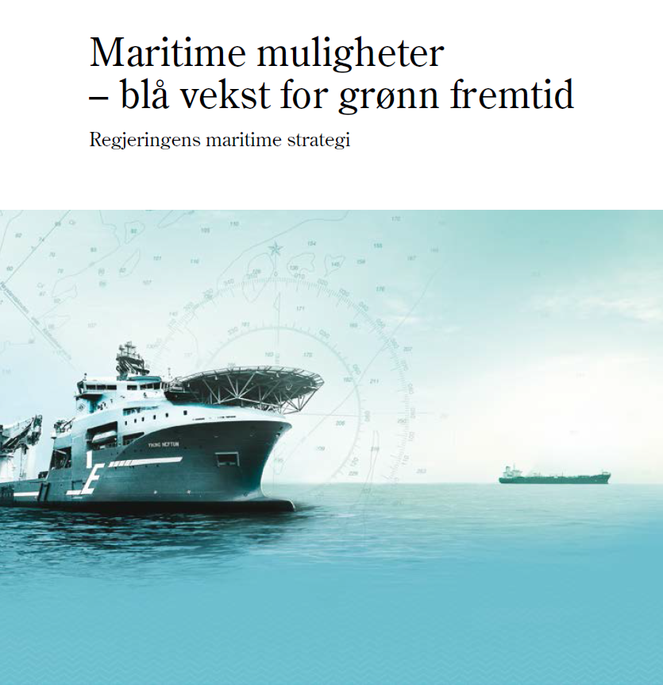

National Maritime Strategy

Slide 5
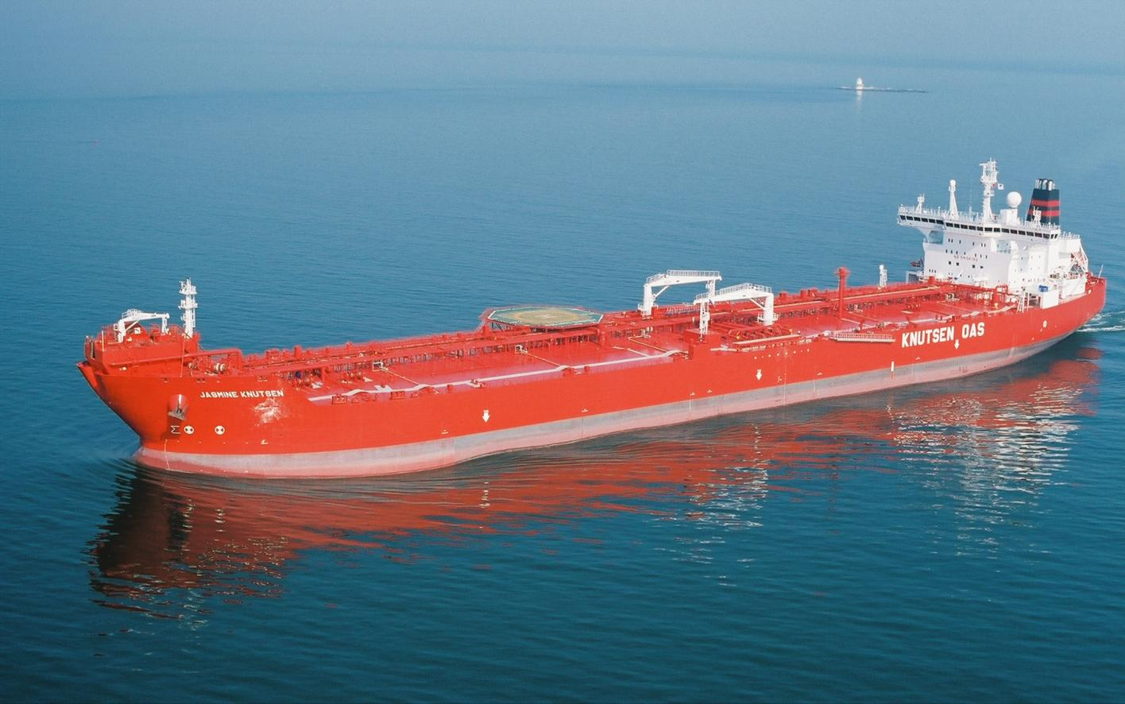


Topics of concern
CO2, NOx, SOx, BC
Emissions of
VOC/Freon/Halon gases
Noise
Sewage
and
garbage
Ballast Water
Antifouling
paint
Bilgewater disposal
and Tank washing

Slide 6
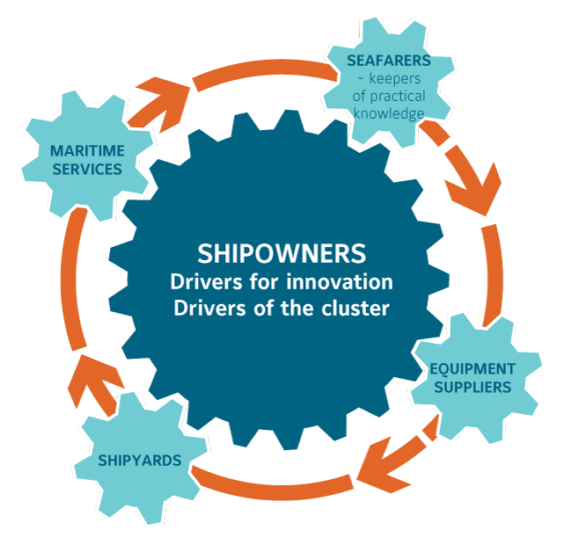
basic principles for innovation
Commercially smarter
Safer
Greener
Notes:
Ampere – first fylle battery driven ferry
Kvitbjørn - LNG driven ferry

Slide 7

Drivers and trends for uptake of new measures to reduce emissions
The world economy and demand for seaborne transport
Regulations
Stakeholder expectations
Technology developments
Fuel developments

Slide 8
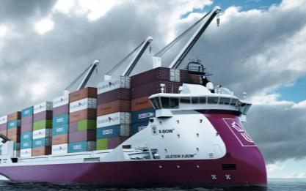
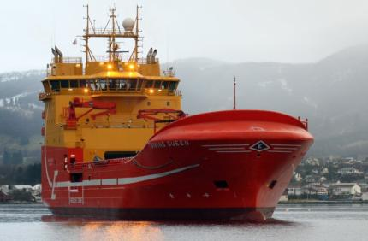
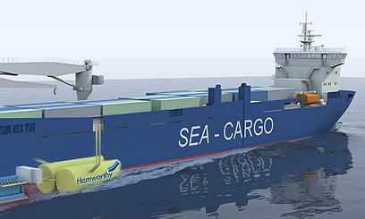
Means for reducing emissions
Designs
New technologies
Alternative fuels and energy carriers
Operational measures
Improved maintenance regimes
New builds
Existing vessel
Ulstein Eurofeeder - container carrier

Slide 9
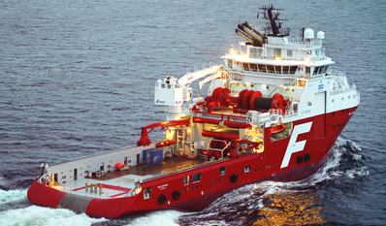
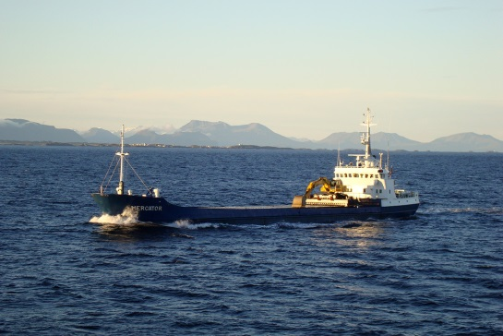
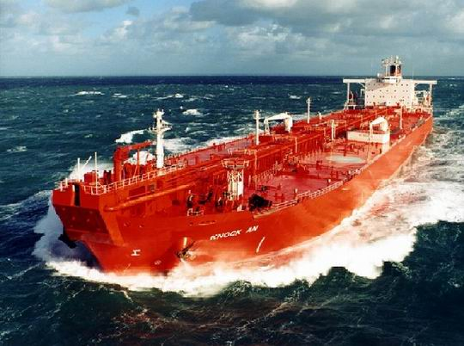
Experiences
Innovative drive and willingness to improve
“Big leap” innovations costly
Market driven measures implement differently than regulatory driven developments
Incentives to improve works
Understanding of the market mechanisms is key
International regulations and enforcement is important

Slide 10
Thank you for your attention

