Slide 1
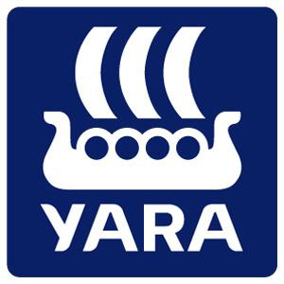
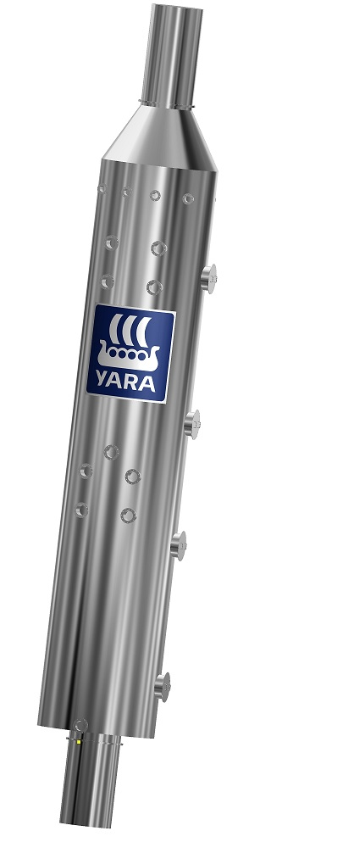
Yara Marine Technologies

Slide 2
Yara International
Key figures
Revenues (2013): USD 14.6 billion
EBITDA (2013): USD 2.3 billion
Number of employees (Number at year-end): 9,759 (8,052 in 2013)
Key facts
Headquartered in Oslo, Norway
Listed on the Oslo Stock Exchange
Global presence with operations and offices in more than 50 countries and sales to more than 150 countries

Slide 3
SOx Scrubbers - A profitable investment ?
Notes:
One typical Ro-Ro liner vessel

Slide 4
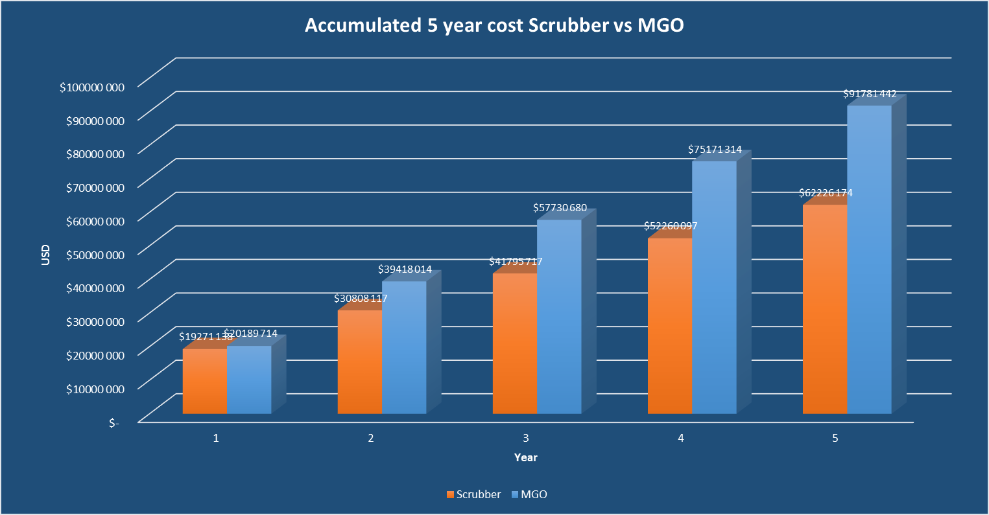
SOx Scrubbers - A profitable investment !

Slide 5
SOx Scrubbers - A profitable investment !

Slide 6
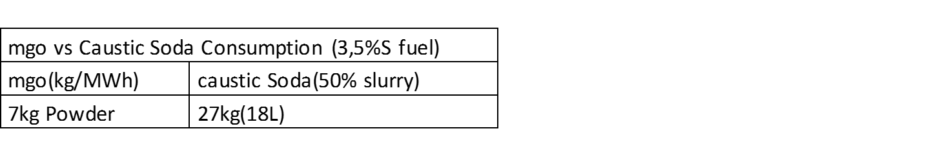
MgO vs NaOH
Safer handling due to mild alkaline properties compared to NaOH, Ca(OH)2, Na2CO3
Much Lower Operational Cost than caustic soda/NaOH
  And NaOH normally requires fresh water for mixing
Higher efficiency
Low storage space requirement onboard
Lower MgO quantities result is less solid waste, hence less disposal cost
No or limited price fluctuation

Slide 7
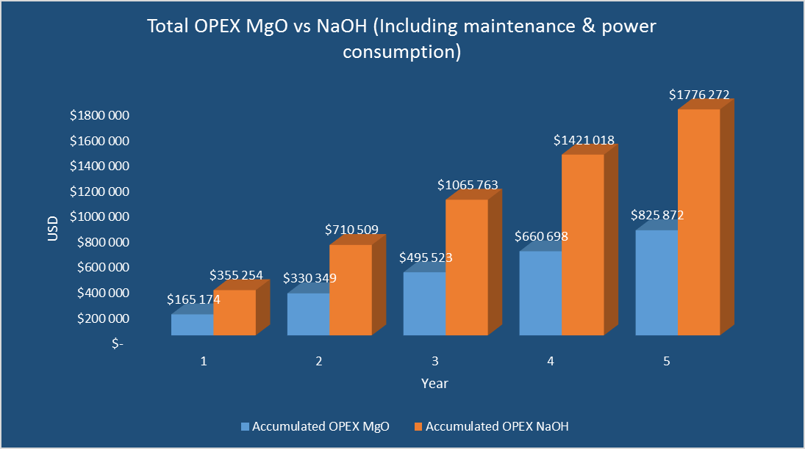
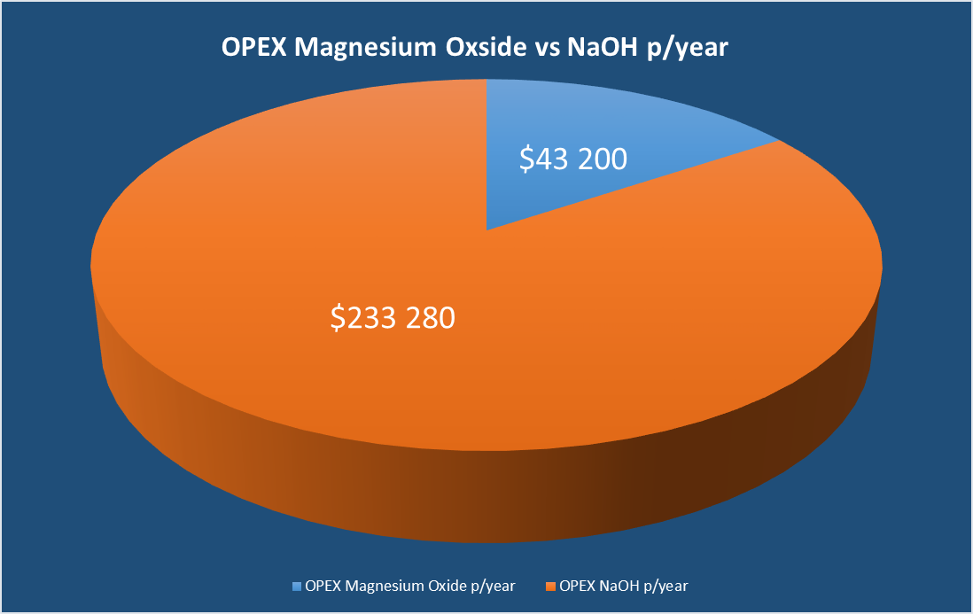
SOx Scrubbers - A profitable investment !

Slide 8
SOx Scrubbers - A profitable investment !

Slide 9
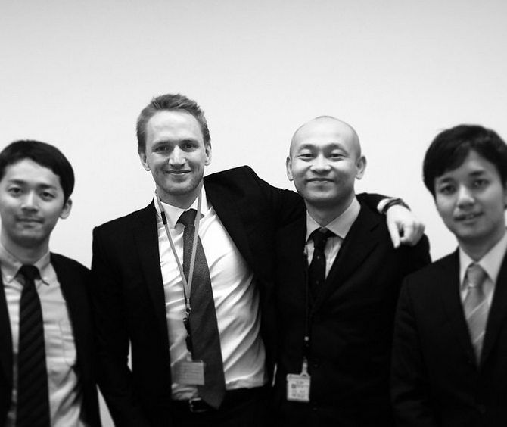
From Norway to Japan (Ministry of Land, Infrastructure and Transport)

Slide 10
Thank you for your attention!
a SMALL solution to a big Challenge
PS
We can send you the calculator - you can play with YOUR numbers….

