Slide 1
Flexible Solutions for
Marine Level Gauging
Oslo
4 June 2015

Slide 2
Presentation Overview
Introduction to Musasino Group
System Philosophy
Global Network
Aftersales Overview

Slide 3
Musasino : Overview
Japan’s No. 1 Tank Monitoring System Maker
Development, Design, Sales, Production & Service of Tank Monitoring and Cargo Handling Support Systems
Established in 1946
69+ Years of Marine Equipment Experience
50+ Years of Commercial Level Gauging Experience
Installations on over 3500 Vessels
Commitment to Quality
ISO 9001, ISO 14001, IEC 80079-34 Certifications

Slide 4
Musasino Group Structure
Complete integration from Production to Customer Interaction
Commitment to Lifetime Quality of Products and Relationships

Slide 5
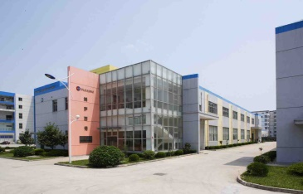
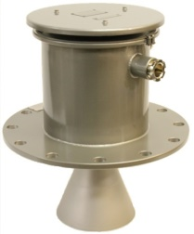
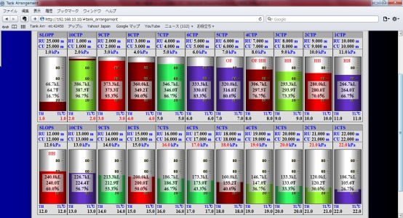
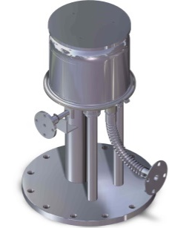
Last 10 Years - Global Developments
Musasino Marine and Offshore
Established in Singapore
Musasino Tech (Factory)
Established in Suzhou, China
Musasino Taiwan
Established in Taiwan
Musasino HK (Corporate Office)
Established in Hong Kong
Musasino Shanghai (Tech Branch)
Established in Shanghai, China
Musasino Shanghai FTZ
Established in Shanghai, China
2003
2007
2011
2012
2014
2003
2005
2014
Air-purge level gauge
Level Aeran 2
5th Generation
Radar Level Gauge,
X-Radar
Cargo Handling Support System,
software to assist in loading operations
LNG Radar Level Gauge
for Custody Transfer,
LNG-Radar
Notes:
- Push to establish presence in international markets to better serve all stakeholders
- Complete and complimentary product range that builds on previous generations’ know-how and augments system effect benefits
- Serving new segments (LNG Custody Transfer, Offshore) with products developed and produced in-house guaranteed by the Musasino name.

Slide 6
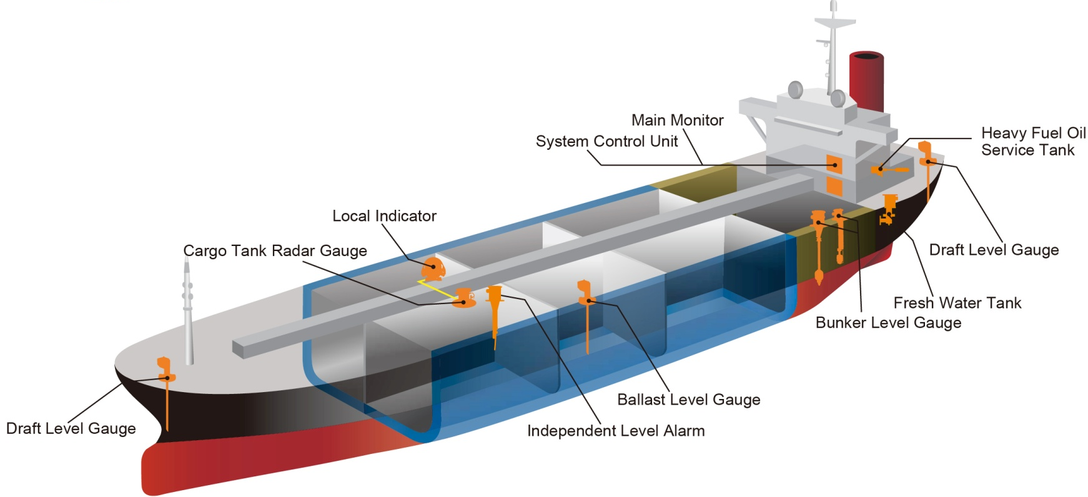
System Solution Focus
Integrated Solutions for Safe Cargo Operations

Slide 7
Musasino Global Sales & Aftersales Offices
And Authorized Agents
The Netherlands
U.S.A
Japan
China
Taiwan
Hong Kong
Singapore
Global Offices
Agents

Slide 8
Product Life Cycle Maintenance
Equipment delivered in full working condition tested and verified
System New Delivery Condition
Annual inspection
3-5 yearly
Full Calibration
10 -15 yearly refurbishment and Major over-haul
Upgrades as per requirement
Support upgrades such as remote wheel house display, additional sensors, additional interface, increase alarm channels as per oil major / owner requirement
Often requested by owner for vetting inspection purposes with factory issued Certificate
Carried out during vessel docking in yard. Full and detailed maintenance program with recommended spares based on current condition
Recommended for major overhaul and replacement of critical parts. Full calibration and certificate issued by factory

Slide 9
Product Life Cycle Maintenance
Vessel Information
Newbuilt yard/hull No.
IMO no
Service & Technical Information
Vessel Specific Final Drawing
Spare List
Vessel History
Service Reports
Full service records
Owner/Manager
Year built
Technical Manuals
1 Stop Service Contact
MMAO as Single point of Contact
Global Service / Spares Coordination
Technical Advise
Centralised Information Storage for Service Support
Service Database
Musasino Marine And Offshore
(Singapore office)

Slide 10
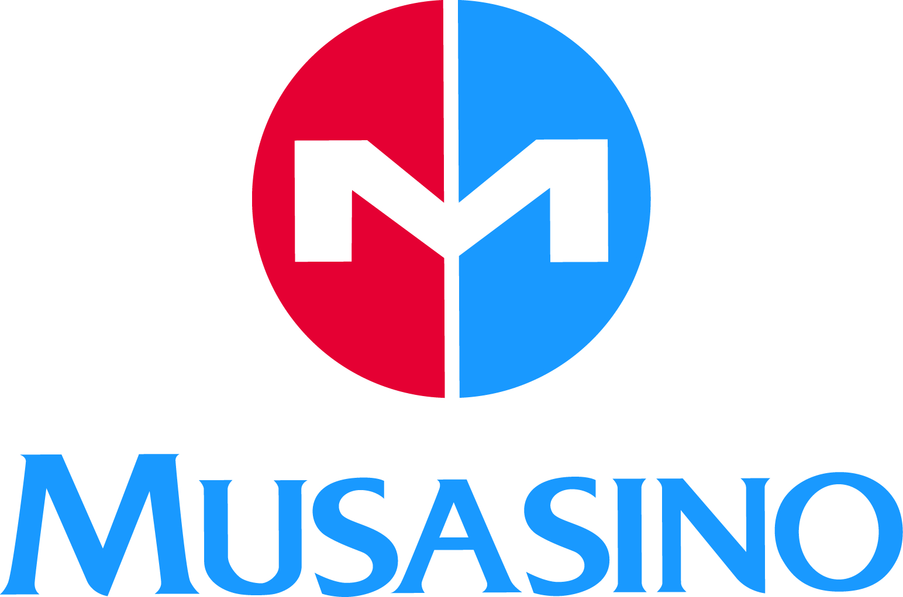
©Musasino 2015

